Slide 1
Mashups and Web Services
Sources: Adrian Giurca, Emilian Pascalau, Mashups and Web Services

Slide 2

What is a Mashup?
A mashup is a new song that is mixed from the vocal and instrumental tracks from different source songs (usually belonging to different genres).
How the mixing is done gives the value of the mashup

Slide 3

What is a Web Mashup?
A Web Mashup is a web application that is mixed from different other web applications (usually belonging to different domains).
How the mixing is done gives the value of the mashup.

Slide 4
Why Do We Need Mashups
To foster innovation by unlocking and remixing information in ways not originally planned for
To uncover new business insights by easily assembling information from multiple sources
To increase agility by supporting dynamic assembly and configuration of applications
To speed up the development
To reduce development costs through lightweight integration, reuse and sharing

Slide 5
Server-Side Mashups
Server-Side Data Mashup - it’s still hard to mashup up data across databases from different vendors. This points out that many applications we have today are early forms of mashups, despite the term.
Server-Side Software Mashup - Combining server-side is easier right now since Web Services can use other Web Services …

Slide 6
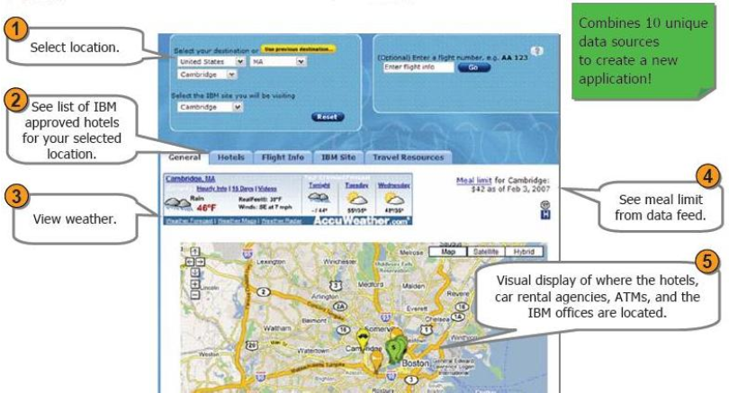
IBM Trip Planner (server-side)
Many similarities with typical web applications (what's new?)
Low or none user innovation/creativity

Slide 7
Client-side Mashups
Client-Side Data Mashup - takes remote information (from Web services, feeds, or even just plain HTML ) and combines it with data from another source. New information that didn’t exist before can result.
Client-Side Software Mashup - the code is directly integrated in the browser to result in a distinct new capability. There is considerable potential in being able to easily wire together services into new functionality.
Presentation Mashup - Showing existent information in another way (e.g. Ajax Based “desktops”).

Slide 8
Real Mashups are Client-Side
Server-side mashups looks like classical server applications but using Data and API’s/Services offered by many platforms (Google, Amazon, Yahoo, YouTube, Flickr, Reuters, CNN, …). They have to be built by skilled programmers
Client-side mashups are created by simple users (business people), typically using widgets and feeds.

Slide 9
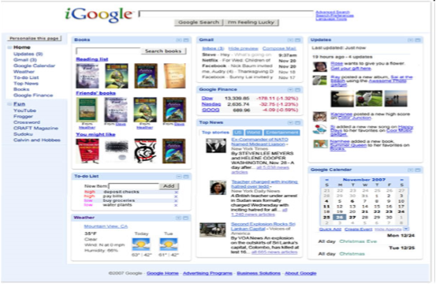
iGoogle
probably the most complex user-defined mashup
is a collection of Gadgets
but Gadgets are proprietary applications
as well Microsoft Gadgets, Apple Widgets, ...
for any service you want to use, you have to built/reuse a Gadget ...
iGoogle aims to be the (Google) user interaction page with the Web
However, users would like to build mashups by aggregating from different services and platforms

Slide 10
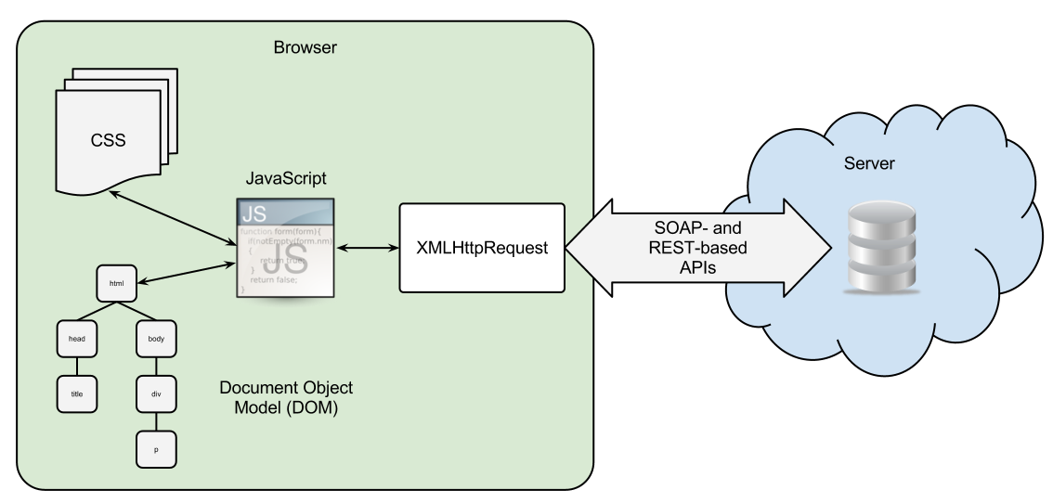
Web Application: Client/Server with REST-based APIs

Slide 11
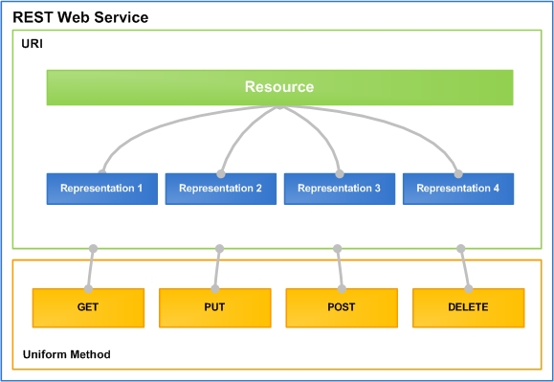
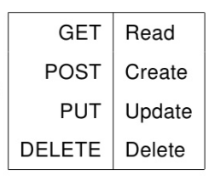
REST Web Services
Representational State Transfer (REST): The new representation places the client application into yet another state. Thus, the client application changes (transfers) state with each resource representation

Slide 12
REST (Representational State Transfer) (1)
REST is an architectural style for networked hypermedia applications, used to build Web services (restful services) that are lightweight, maintainable, and scalable.
For example, Yahoo weather defines a forecastrss resource.
Clients may access this resource with the URI: http://weather.yahooapis.com/forecastrss?p=GMXX0007&u=c
When a client requests this URI, a representation of the resource is returned, in this case an RSS 2.0 XML file
The representation places the client application in a state. The result of the client traversing an existent hyperlink in the representation is another resource that is accessed.

Slide 13
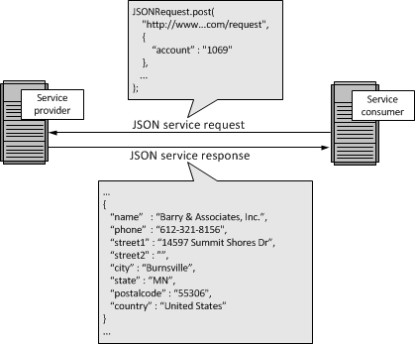
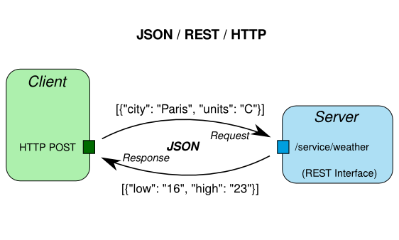
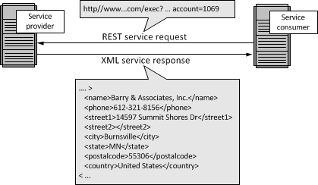
REST between Client and Server

Slide 14
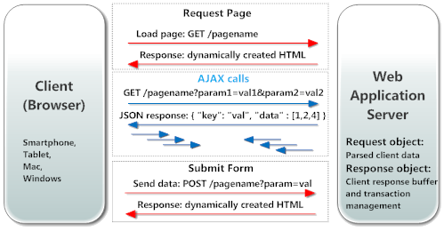
REST between Client/Server (AJAX)

Slide 15
RESTful Service: Example (2)
http://weather.yahooapis.com/forecastrss?p=GMXX0007&u=c
This is a GET query to the Yahoo Weather REST service. The answer is RSS and looks like (When making a request to a REST WS, usually the data is returned in XML format. REST has no standard structure for the data. A REST Web Service returns an (XML) response defined by the service provider):
<rss version="2.0" xmlns:yweather="http://xml.weather.yahoo.com/ns/rss/1.0" xmlns:geo="http://www.w3.org/2003/01/geo/wgs84_pos#">
<channel>
<title>Yahoo! Weather - Berlin, GM</title>
<link>http://us.rd.yahoo.com/dailynews/rss/weather/Berlin__GM/*http://weather.yahoo.com/forecast/GMXX0007_c.html</link>
<yweather:location city="Berlin" region="" country="GM"/>
<yweather:units temperature="C" distance="km" pressure="mb" speed="kph"/>
<yweather:wind chill="30" direction="150" speed="12.87"/>
<yweather:atmosphere humidity="31" visibility="9.99" pressure="1015.92" rising="2"/>
....
</channel>
</rss>

Slide 16
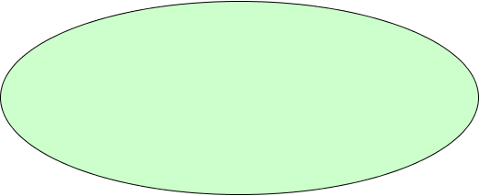

Data Mashups and REST
Data Mashups combine different data (feeds) to obtain new data (feeds)
But typically the feeds are accessed in a REST way
So we can say that by orchestrating REST services we can do data mashups
REST Services Orchestrations
Data Mashups

Slide 17
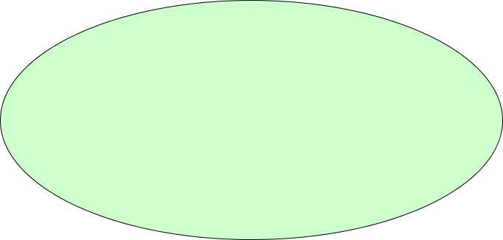


Software Mashups and REST
Typically combine different services and data to obtain a new service.
This looks like Web Service orchestration
REST Services Orchestrations
Software Mashups
Data Mashups

Slide 18
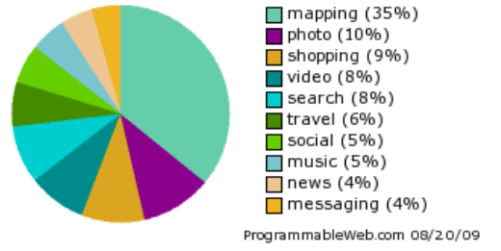
Server Side Mashups
Orchestrating Web Services (both REST and SOAP) is performed for a long time.
The server side mashup do the same usually accessing (REST) services via public APIs
One may argue that is not only about REST, but look on the above classification at http://programmableweb.com/
All involved services provide REST interfaces!

Slide 19
Client Side Mashups
Orchestrating (SOA) REST Web Services in the Web browser.
Handle the user activities on the page and use it to obtain much more capabilities.
Involve users in mashup creation (Web 2.0) by
Allowing users to choose services they want to use
Allowing users to design the orchestration
Most of the mashups do not allow users to change the behavior
http://www.22books.com/ allows users to create and share book lists using the Amazon services. But the users are not allowed to change this service.
http://1000songs.ebotunes.com/ just show you "1000 songs" and provide us some search capabilities. They use Guardian, Last.fm, and LyricWiki APIs
Mashups = (REST + SOA) * Web 2.0

